Slide 1
Comparative Analysis of Optimization Algorithms and the Effects of Coupling Hedging Rules in Reservoir Operations
Gi Joo Kim
Research Group for Climate Change Adaptation in Water Resources
Department of Civil and Environmental Engineering
Seoul National University

Slide 2
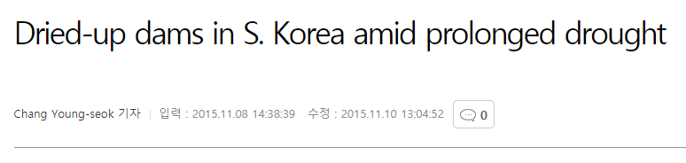
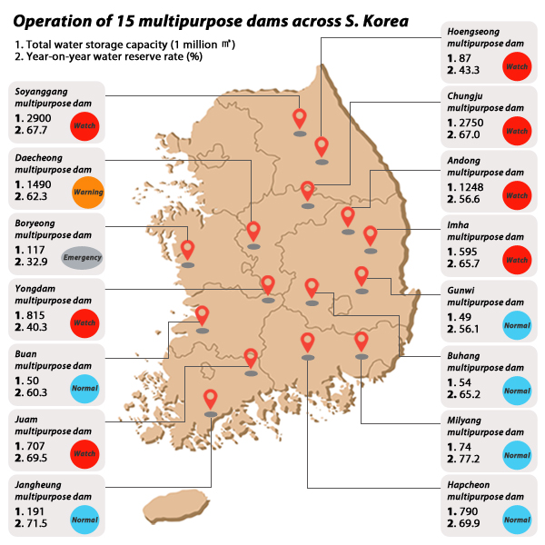
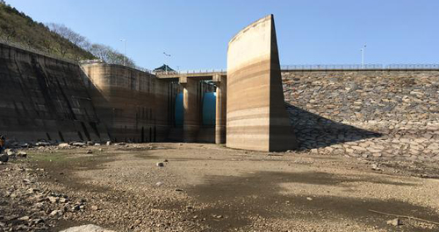
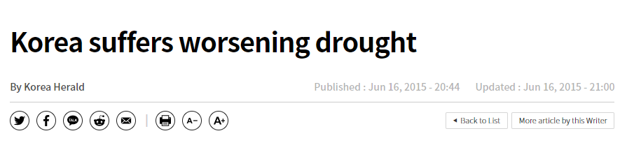
Recent multi-year droughts in Korea
(MBN, 2015)
(Korea Herald, 2015)
Fig. 1. Articles regarding the recent
multi-year droughts in Korea
Notes:
Both the background and the motivation of this study started from multi-year droughts that happened in Korea from 2014-2019.
The picture below is the same reservoir you saw from the title page.

Slide 3
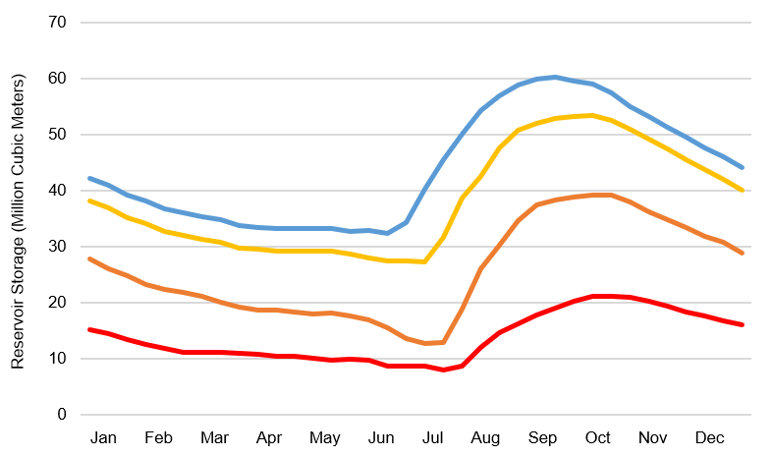
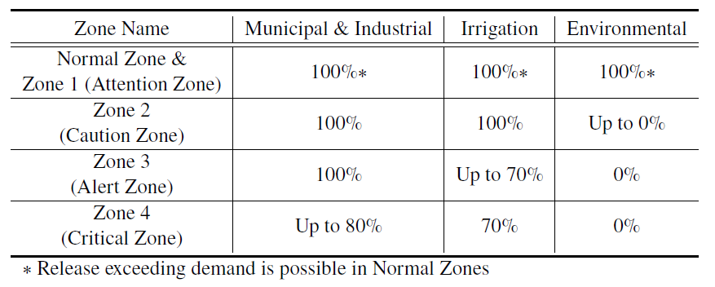
Real-world policy in Reservoir Operations
Real-World Policy: Zone-based Hedging Rule
Discretizes the entire range of storage into Zones (Fig. 2.2)
Release decisions are determined according to the “Zone” the current storage belongs to
Selected as the main operating policy in all Korean multipurpose reservoirs (currently, 20 multi-purpose dams each with different curves)
Normal Zone
Table 1. Ratios implemented during hedging
Zone 1
Zone 2
Zone 3
Zone 4
Fig. 2. Actual Rule Curves of Boryeong Reservoir, Korea

Slide 4
Key Research Questions
How does different optimization models or their formulations affect both the quality and the diversity of solutions in reservoir operation problems?
How about when the reservoir was operated with the status quo (SQ) rules? How do they perform under both drought and normal conditions compared to optimal solutions?
How does the implementation of SQ rules with the solutions from optimization algorithms improve (or degrade) the performance under extreme drought conditions?

Slide 5
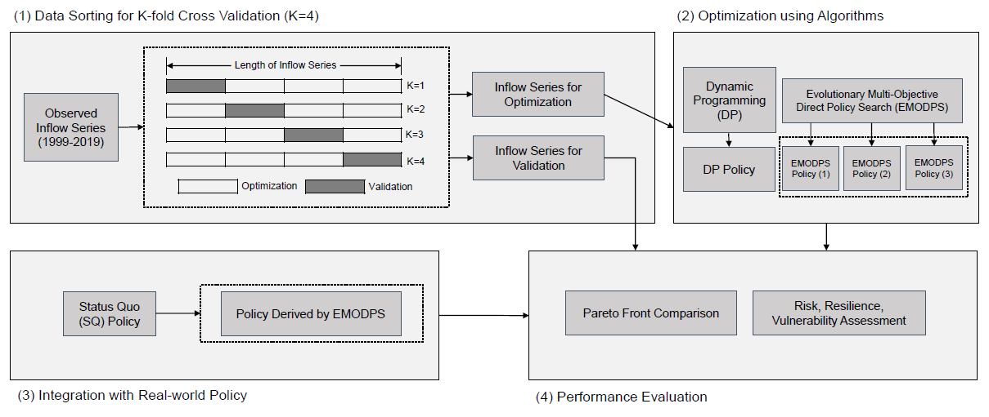
Flow Chart of Overall Research
Fig. 3. Overall Flow Chart of this Research
Keywords: Reservoir operation, Dynamic programming, Evolutionary multi-objective direct policy search, Zone-based hedging rule

Slide 6
Optimization Techniques for RO
Selected Optimization Algorithms
Dynamic Programming
Discretizes the entire range of state, decision, and disturbance variables for iterative calculation that lead to the steady-state solution
Deterministic and stochastic versions of the DP models depending on the available information
Evolutionary Multi-Objective Direct Policy Search (EMODPS)
Direct Policy Search (DPS) (Rosenstein and Barto, 2001)
A type of parameterization-simulation-optimization (PSO) approach in which the decision variable directly operates in the policy space
Nonlinear approximating networks: Radial Basis Function (RBFs)
Approximating function that determines the value of the release decisions
MOEAs during the solution searching process
Iterative search algorithm that evolve a Pareto-approximate set of solutions in a multi-objective problem

Slide 7
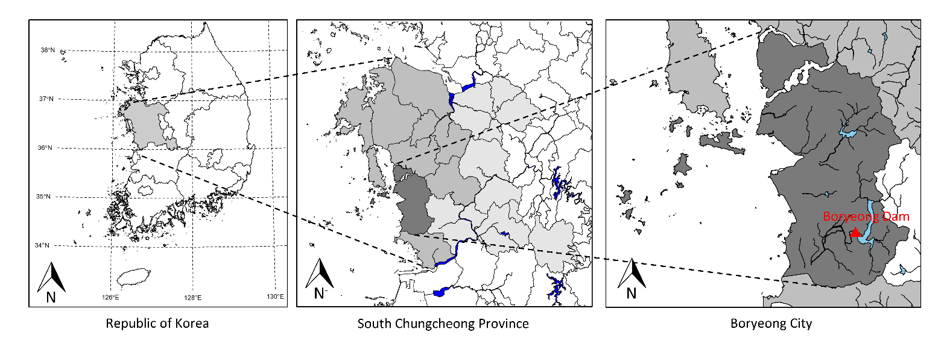
Case Study: Boryeong Multipurpose Reservoir
Watershed Area: 2,860 km²
Water Supply Districts (8, Light Gray) Boryeong (Dark Gray), Seosan, Dangjin, Seocheon, Cheongyang, Hongseong, Yesan, Taean
Water Use: 106.6 MCM/year (Reservoir Capacity: 116.9 MCM) (Municipal & Industrial water demand: 84%, Agricultural water demand: 5%, Environmental water demand: 11%)
Fig. 4. Map of the study basin

Slide 8
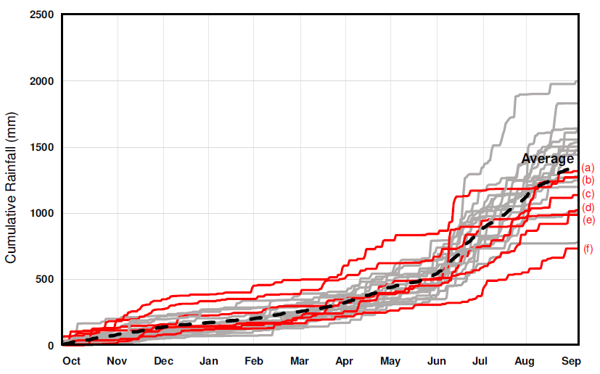
Case Study: Boryeong Multipurpose Reservoir
Recent Multi-year Drought in Boryeong Dam Basin (2014-2019)
Consecutive decrease in the total annual precipitation (6 water years)
Both structural/non-structural measures to mitigate the effects from the long-lasting drought
Conduit Construction Project (2016-2017, $62,500,000+$2,600,000/year)
Enforcement of Pressure Reduction in Water Supply Systems (127 days)
(a)~(f): cumulative rainfall during water years 2013-2014 through 2018-2019
29% Decrease
In Total Inflow (2015-2017)
Inflow (cms)
Fig. 5. Graphs of recent inflow decrease of Boryeong Dam

Slide 9
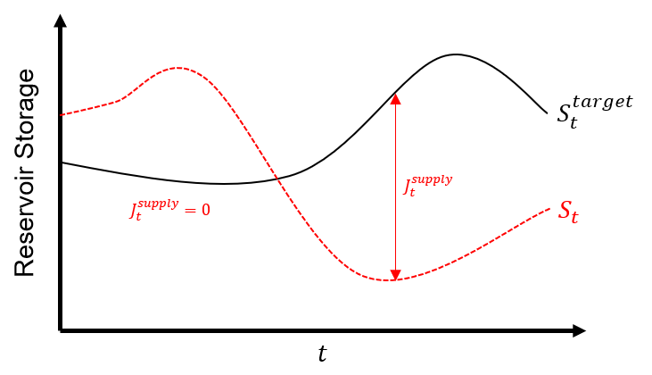
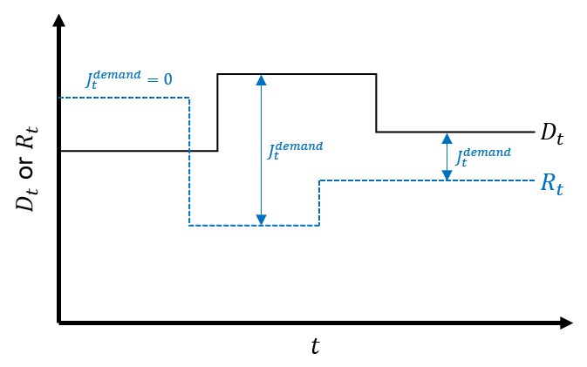


Problem Formulation: Objectives
Reservoir Problem with Conflicting Objectives: $J^{supply}$ vs $J^{demand}$
(both objectives to be minimized)
$J^{supply}$: measures the magnitude of failure from the supply side
$J^{demand}$: measures the magnitude of failure from the demand side
(a)
(b)
Fig. 6. Illustration of (a) $J^{supply}$ and (b) $J^{demand}$

Slide 10
Problem Formulation: Optimization Models
2-Obj. Optimization Models for Optimal Reservoir Operations
Dynamic Programming-based Models with different information
Deterministic DP-Perfect (DDP-Perfect)
Deterministic DP-Monthly Average (DDP-Average)
Stochastic DP (SDP): Assuming lognormal distribution of inflows
Evolutionary Multi-Objective Direct Policy Search (EMODPS) Models with different RBF shapes & number of parameters
EMODPS-Linear: Linearly shaped RBF with 4 policy parameters
EMODPS-Gaussian: Gaussian shaped RBF with 3 policy parameters
EMODPS-Root: Root shaped RBF with 6 policy parameters (j=2)

Slide 11
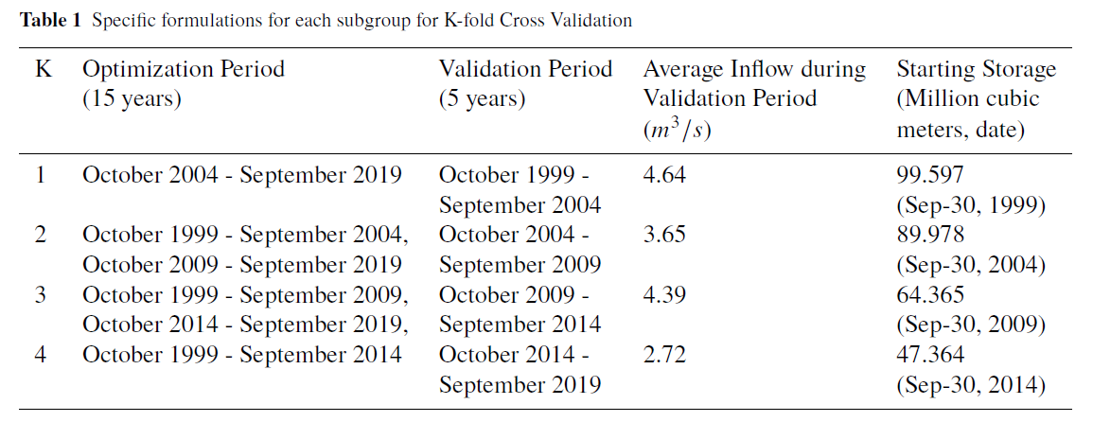
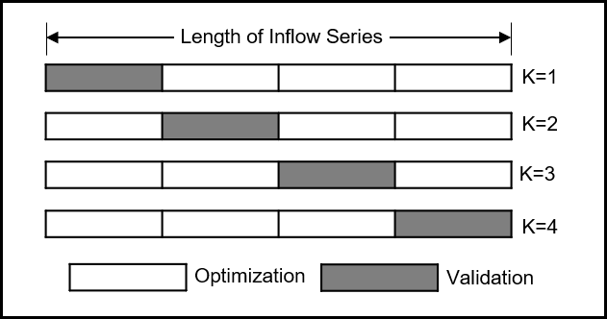
Problem Formulation: Simulation
K-fold Cross Validation (CV) Formulation
Table 2. Specific formulations for each subgroup by K-fold Cross Validation
Drought period with
low starting storage
(K=4)
Fig. 7. Concept of K-fold CV

Slide 12
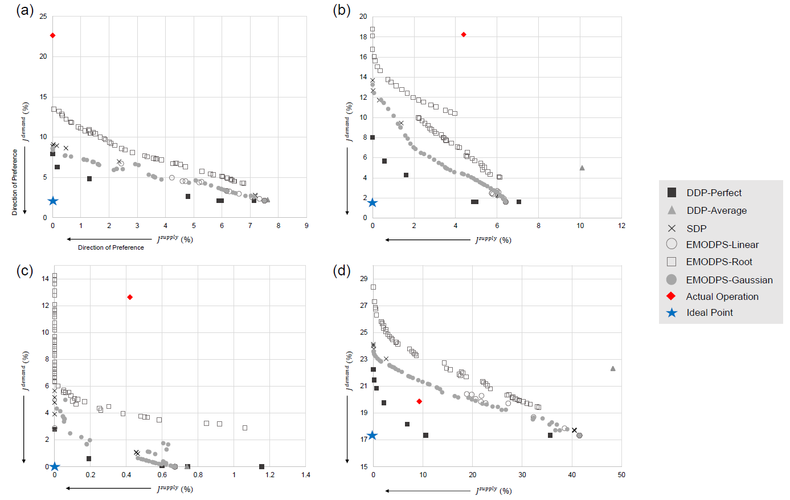
Results: Comparison among Models
Fig. 8. Pareto Fronts of the solution sets derived by each subgroup in K-fold CV
(a) Subgroup K=1, (b) Subgroup K=2, (c) Subgroup K=3, and (d) Subgroup K=4

Slide 13
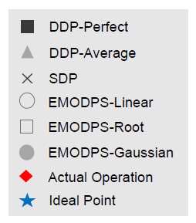
Results: Comparison among Models
Insights from comparison among optimization models
Among the EMODPS models, EMODPS-Gaussian model (●) with least number of parameters (3) performed best among all other models
Shape of the approximating function is more important than the number of parameters in this case
Solutions from the SDP model (Ⅹ) performed as well as the EMODPS-Gaussian model (●) in most of the subgroups, but they failed in terms of solution diversity (due to commensuration of objectives)
Policy searching closed-loop models (SDP & EMODPS models) were more flexible than the deterministic open-loop models (DDP-Average, ▲)
Actual operation based on the SQ policy (◆) based on zone-based hedging rules hold value under drought conditions (K=4)

Slide 14
Results: Coupling of Real-world Policy
During simulation, real-world reservoir operating policy is coupled with the best performing optimization model: EMODPS-Gaussian
Normal Zone
Zone 1
Zone 2
Zone 3
Zone 4
Fig. 9. Actual Rule Curves of Boryeong Reservoir, Korea
Table 3. Ratios implemented during hedging
Fig. 8(d). Pareto Fronts of the solution sets
derived from Subgroup K=4

Slide 15
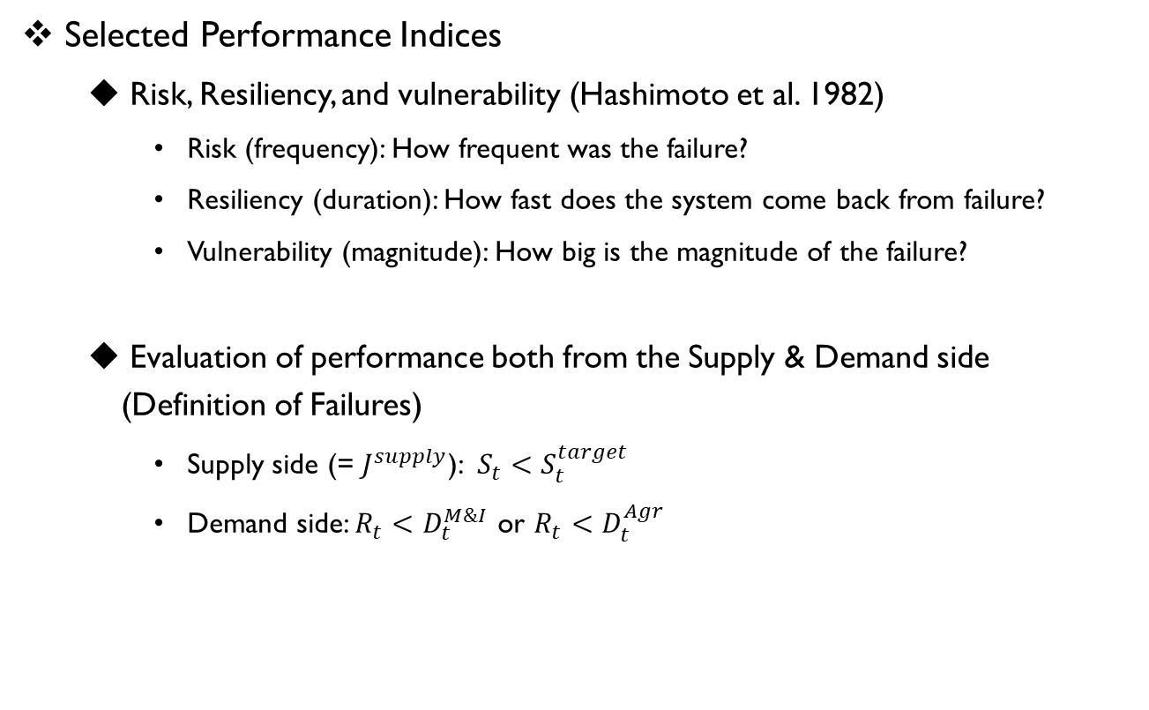
Results: Coupling of Real-world Policy
Selected Performance Indices
Risk, Resiliency, and vulnerability (Hashimoto et al. 1982)
Risk (frequency): How frequent was the failure?
Resiliency (duration): How fast does the system come back from failure?
Vulnerability (magnitude): How big is the magnitude of the failure?
Evaluation of performance both from the Supply & Demand side (Definition of Failures)
Supply side (= $J^{supply}$): $S_{t}<S_{t}^{target}$
Demand side: $R_{t}<D_{t}^{M\&I}$ or $R_{t}<D_{t}^{Agr}$

Slide 16
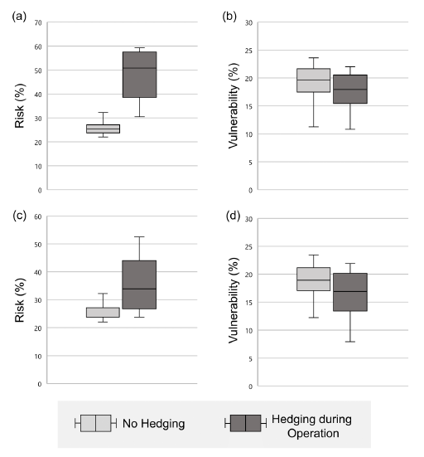
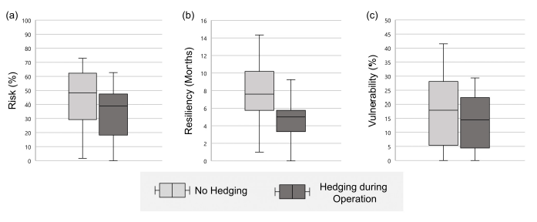
Results: Coupling of Real-world Policy
*Risk Aversion*
Fig. 10. Performance indices measured from the supply side: (a) risk, (b) resiliency, and (c) vulnerability
Fig. 11. Performance indices measured from the demand side: (a) risk of water for A uses, (b) vulnerability of water for A uses, (c) risk of water for M&I uses, (d) vulnerability of water for M&I uses,

Slide 17
Conclusion: Take-home Messages
Under normal conditions, solutions from optimization models surpassed the results from actual operations
There are definitely potential room for improvements with the introduction of optimization models!
Among the optimization models, solutions from the EMODPS models dominated those from the DP models both in terms of proximity to the ideal point and the variety of solutions across the Pareto front
Coupling of zone-based hedging rule with the solutions from the optimization models resulted in outcomes favorable to risk-averse real-world water users (may hold promise)
Notes:
Rather than shouting that the rules you are using is trash, but they actually do have the potential to be implemented in real-world situations as well.

Slide 18
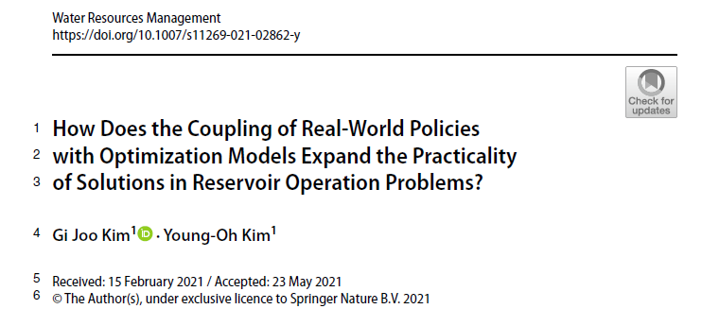
Related Publication
For More…
Kim, G. J. and Kim, Y.-O.* “How does the coupling of real-world policies with optimization models expand the practicality of solutions in reservoir operation problems?” Water Resources Management. (in press)

Slide 19
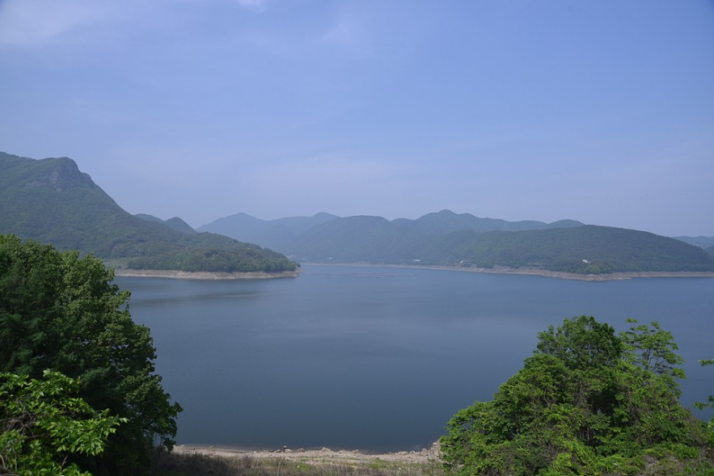
Thank You!
(Boryeong-si, 2020.05.)

